Slide 1


Community Hospital Transitions Program Expansion
April 3, 2018

Slide 2
Transitioning Veterans to VA after
Community Hospitalization is Challenging
Lacked standardization across healthcare systems:
    Communication between healthcare systems
    Information transfer
    Follow-up care with VA Medical Home
Identified a need for education about transition processes
    Veterans
    VA and Community Providers
Designed an intervention to address gaps and inefficiencies
Recognized need for longer care coordination
Notes:
We designed our intervention to address the gaps and inefficiencies we found when we interviewed Veterans, VA and community providers and staff. We also recognized that some Veterans needed more than just a brief episodic help during this transition period.
Barriers
Medical record transfer is problematic
Primary care team is understaffed
Non-VA hospitals are unaware of transition process and VA communication pathways
Veterans are unclear about transition process
No standardized internal VA communication procedures
Veterans not enrolled in VA or assigned a PCP at time of non-VA hospitalization
Obtaining medication from VA pharmacy after discharge is problematic

Slide 3
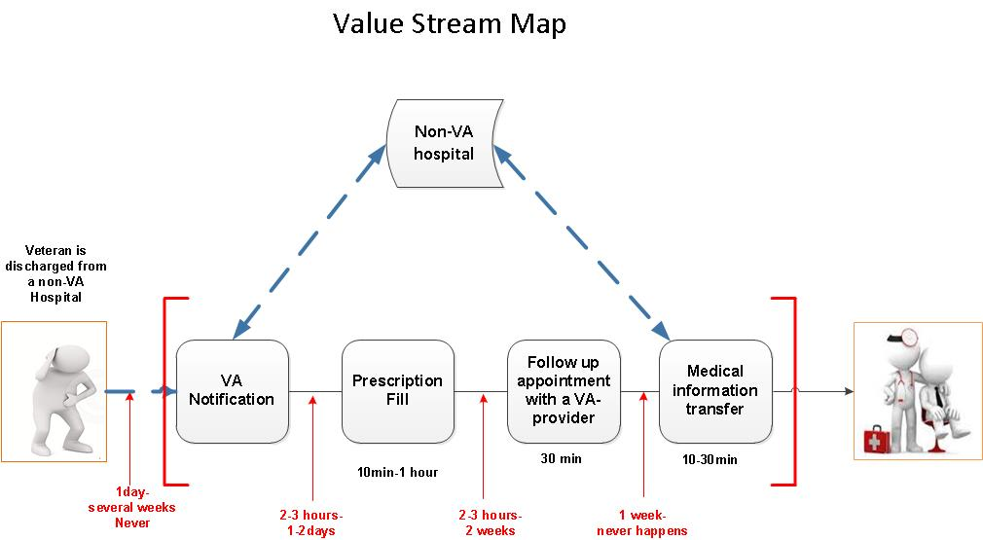
“The Process Is There Is No Process”

Slide 4
Community Hospital Transitions Program
Phase 1 focuses on short-term/episodic care coordination when Veterans are discharged from a community hospital and transition back to their VA Medical Home for follow-up care
Notes:
Phase 1 provides care coordination to Veterans after discharge from a community hospital so they can receive follow-up care at their VA primary care medical home.
As you may recall – there are 4 core components to this intervention:
Once notified of a community hospital discharge, the transitions nurse helps the Veteran obtain a timely follow-up care including an appointment with PCP, discharge medications and other needed services. We also obtain the discharge summery and upload it into CPRS with an overview for the PACT team.
We implemented a dedicated phone line and an electronic fax line for community hospitals to notify the community transitions nurse and send the discharge summary.

Slide 5
Notification of Community Hospitalization
Discharge Summary/
Information Transfer
Follow-up Coordination
Hand off to VA PCP
Notes:
The Non-VA Hospital Discharge Care Coordination Nurse
System Changes
Resource Guide for Non-VA hospitals, VA Primary Care, and Veterans
Measurable Program Outcomes
Here are the main components to our intervention based on this input from interviewees, operational partners, and the literature.
The Non-VA Hospital Discharge Care Coordination Program is a multi-pronged approach that includes:
The Non-VA Hospital Discharge Care Coordination Nurse
System Changes
Resource Guide for Non-VA hospitals, VA Primary Care, and Veterans
We have also identified measurable program outcomes
We are using PRISM (Practical, Robust Implementation and Sustainability Model) to guide the integration of our findings into practice.
.
Next, I’ll provide more detail of each of these components

Slide 6
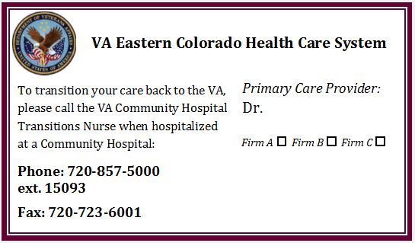
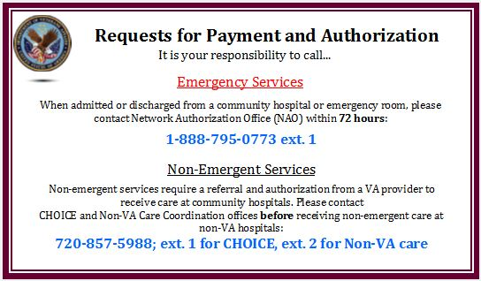

Slide 7
Program Data
Total Veterans in database: 829
Total Hospitalizations in the database: 968
Hospitalizations resulting in a follow-up PCP appointment within 14 days: 205
Total Community Hospitals reached: 36
Notes:
May 2017: Hired Community Hospital Transitions Nurse
June 2017: Implemented Community Hospital Transitions Program and Program Database
August 2017-present: Conducted outreach with VA and Community Hospital stakeholders
September-November 2017: Conducted Theoretical Domains Framework Interviews
October 2017: Initiated pre-implementation planning for expansion site at Omaha, NE VA Medical Center

Slide 8
Evaluation Framework: RE-AIM
 | Measures
Reach | Number, proportion, and representativeness of Veterans reached Number, proportion, and representativeness of community hospitals who inform us of Veteran admission
Effectiveness | ED utilization rate after community hospital discharge [**of those Veterans who interacted with our program] 30-day (60 and 90-day) re-admission rates post community hospital discharge [**of those Veterans who interacted with our program] Veteran satisfaction with transitional care using IVR Number, proportion, and representativeness of Veterans who had VA PCP assignment after d/c from community hospitals if no current PCP
Adoption | Veterans who reached out to us post re-hospitalization discharge [Veterans who received our letters] Community hospitals who notified the program of Veteran admission/discharge (specific method important: case manager fax, phone call)
Implementation | Implementation of core components: number of times all or part of the core components are met for each patient Number of medical records received and discharge summaries uploaded Number of follow up appointments made Number of patients who had the full intervention completed Barriers and facilitators to implementation Return on investment/cost
Maintenance | Documentation of rapid prototyping Documentation of local adaptability
Notes:
We are using REAIM to evaluate our program outcomes. RE-AIM proposes that evaluations of QI initiatives must assess not only effectiveness but also scalability (audience reached by the intervention), how readilly targeted users can adopt and implement the program, and possibility of program’s long-term maintenance.

Slide 9
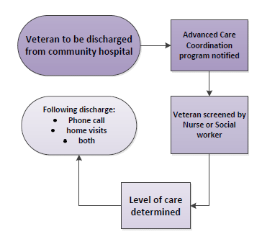
My VA Access: Advanced Care Coordination (ACC)
Phase 2 focuses on providing
access to dual-use Veterans through comprehensive
care coordination
Transitions Nurse
Social Worker
Beyond Transitional Care
Care Coordination based on needs
Notes:
One thing we identified early was that some Veterans really needed more than just transitional care – We are implementing phase 2 of a transitional care program – a pilot program focused on identifying dual use Veterans who are at high-risk for ED and repeat hospitalizations especially due to determinants of health – We have added social worker to our team to work community hospital and VA primary care to assess Veterans needs. We are using a screening tool that is used by PACT social workers to identify level of follow-up care that is needed.
Who will participate?
Veterans who had VA primary care visit within past 12 months
Living in Metro Denver
Care Needs Assessed for Determinants of Health “Hot Spotters”
When will Veterans be contacted?
After a Community Hospitalization (ED or inpatient)
Key components:
Comprehensive health assessment (medical, psychosocial, behavioral, and functional status)
Multidisciplinary approach to address the needs
Transitional Care PLUS Care Coordination/Management
I normally tell hospitals:
The Social Workers will call the Veteran and screen them to determine what level of services are needed
The services range from 1-2 phone calls if the Veteran is low needs to weekly phone calls and home visits for up to 90 days post ED discharge if the Veteran is high needs and requires more intensive services
The support offered depends entirely upon the Veteran’s specific needs at the time they are seen in the ED

Slide 10
What’s Next
Expansion:
  Omaha VA Medical Center and Omaha Community Hospitals
  Second VA site in Oct 2018
Evaluate current Community Transitions Program outcomes using RE-AIM Framework
Continue to collect feedback from VA and Community Hospital providers and staff
Notes:
We are very excited to be working with you!
Our next steps include expanding to Omaha – we are working with their office of community care Dr. David Williams – we have a site champion, Heather Batt and their transitions nurse is stating in a few weeks. We are completing pre-intervention assessment and plan to have a 2-day nurse orientation in Denver that coincides with hands-on training that the rural transitions program is conducting for their expansion sites. We then plan to have a site visit in April to complete pre-intervention data collection prior to implementation.
In addition, we are continuing to collect data and feedback from VA and community providers as well as Veterans to continually improve our phase 1 and phase 2 processes.

Slide 11
Questions for Omaha VA leadership
What is your initial impression of the Community Hospital Transitions Program?
What challenges, if any, do you think there will be to successfully implement this program here?
Any suggestions for rolling out this program in your VA Medical Center?
Notes:
Probes #1
Do you have any concerns about the program?
What do you like about the program?
Probe #2
Do you have any suggestions for overcoming those anticipated challenges?
How should the Community Hospital Transitions Program best fit within your processes of coordinating care for Veterans?

